Slide 1

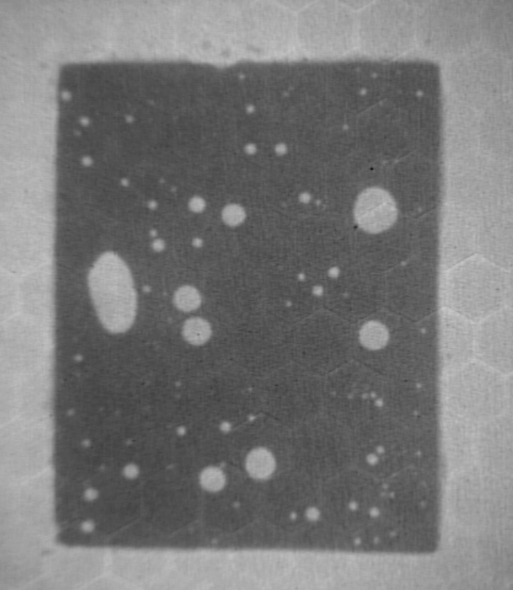
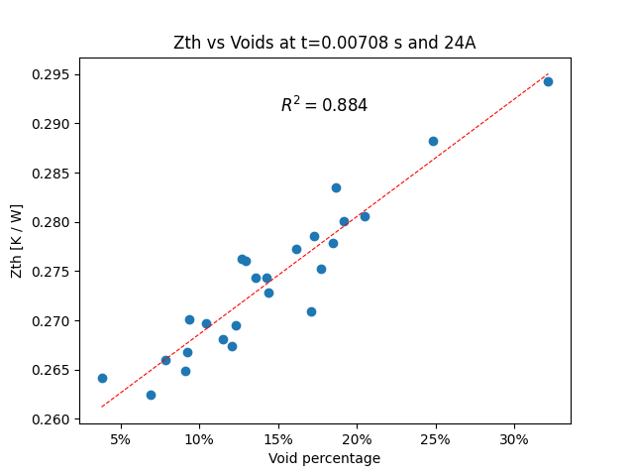
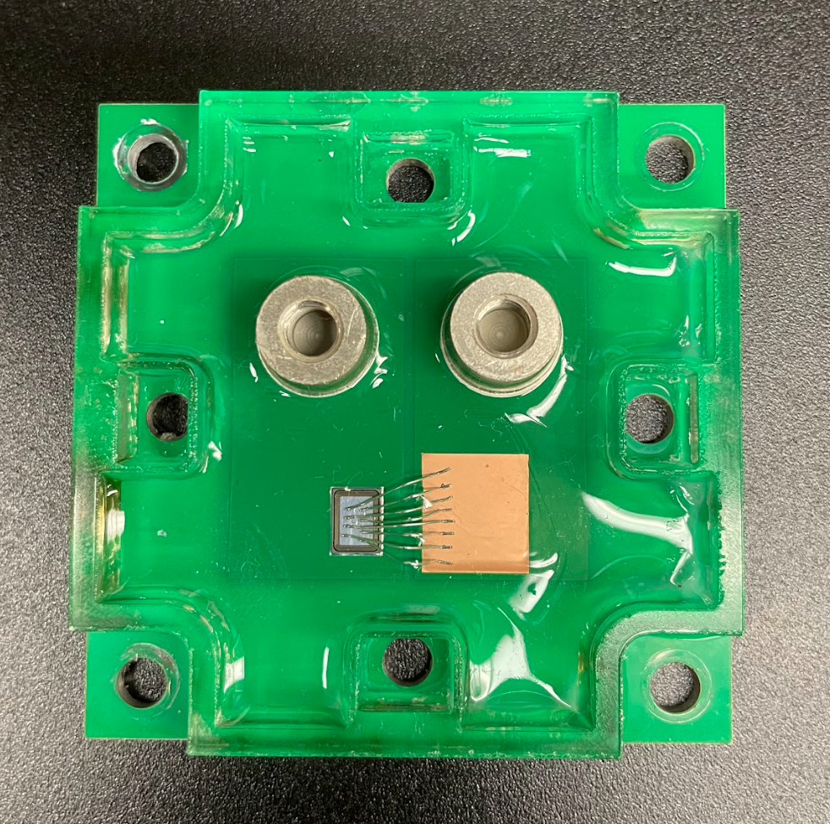
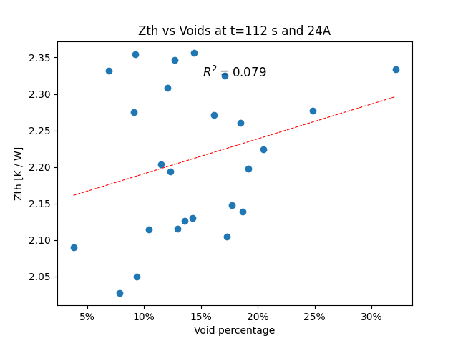
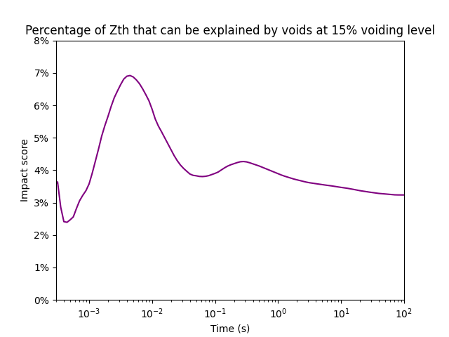
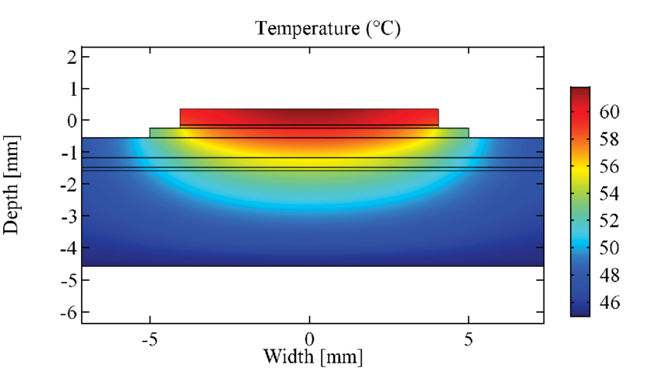
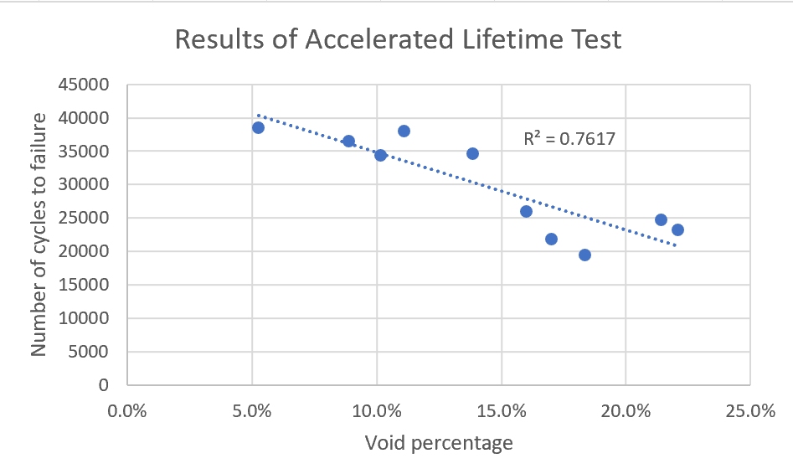
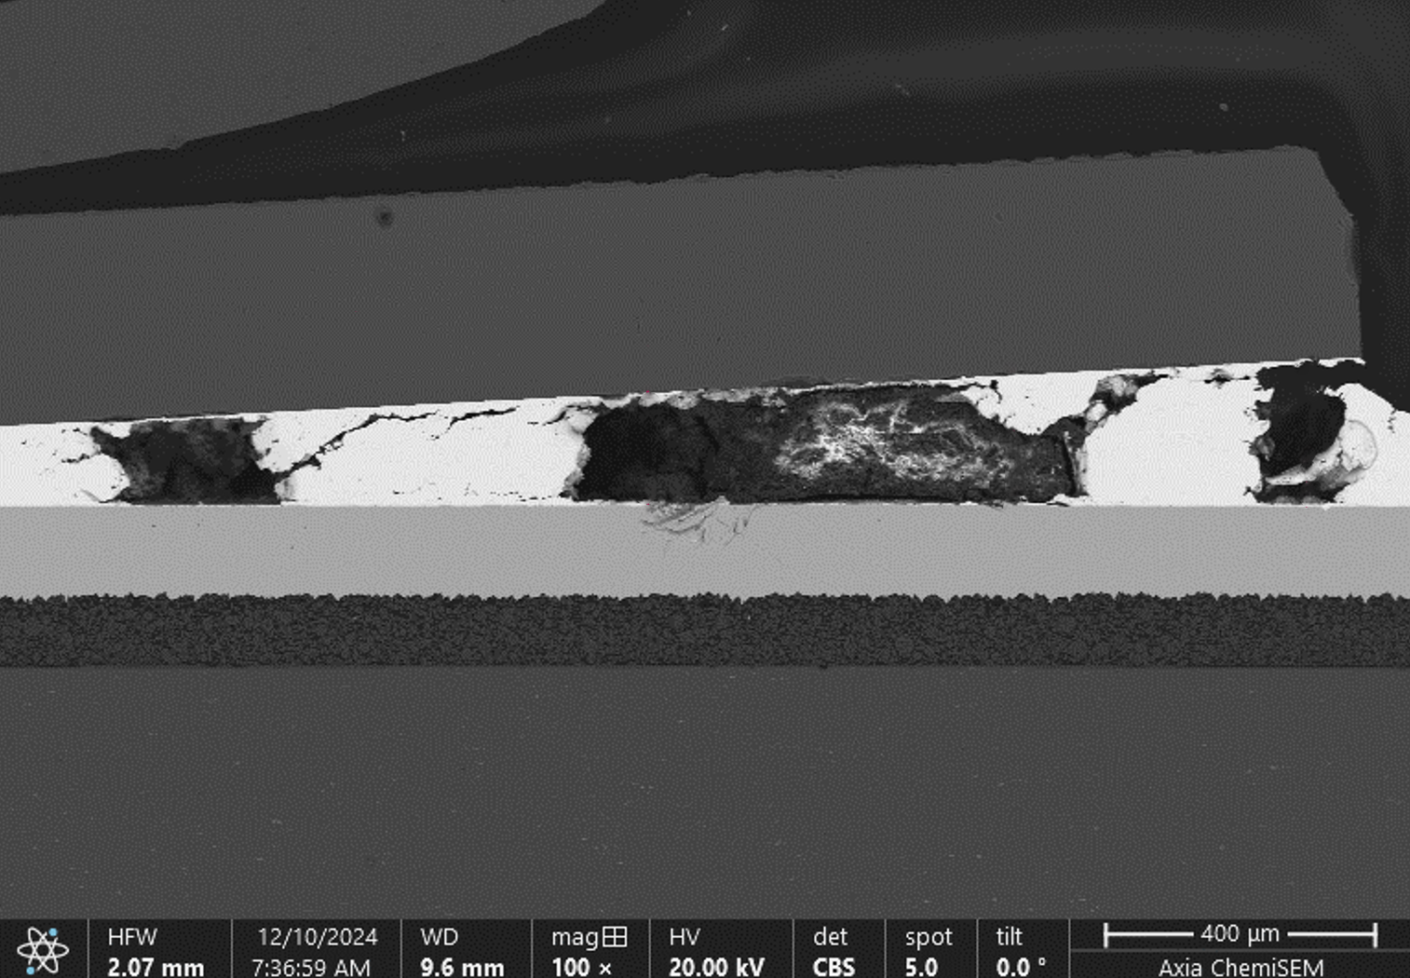
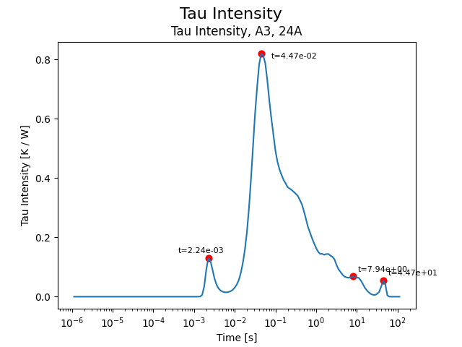
Solder Void Impact on Power Device Thermal Impedance using Transient Thermal Analysis
r
Nathan Carlson | Nick Baker | The University of Alabama
ncarlson@crimson.ua.edu, nbaker2@ua.edu
Motivation
Thermal Impedance Results
Solder voids underneath the chip require expensive equipment to remove. This is especially true for mass production and research labs.
Thermal impedance and lifetime are two key metrics of a power device.
Void percentage = 100% * voided area / total area
At present, there is a relative scarcity of direct experimental evidence between voids and these key metrics.
Diode test module
Tau Intensity Technique
Voids have the most significant impact on thermal impedance on short timescales. This indicates that from a thermal perspective, void removal would help to protect against thermal transient conditions such as a temporary short circuit, but that voids do not have a strong impact on the steady-state thermal resistance.
Problem: The thermal resistance of the solder layer is difficult to isolate due to the variable resistance of other layers.
Lifetime Results
COMSOL simulated image from [1].
Solution: The impedance can be measured a short time after applying a heating current. This time should be a point when the heat flux through the solder is high but has not fully reached the lower layers. The Tau Intensity plot can help to select this time (about 2-5 multiples of the solder layer’s time constant).
Voids accelerate the growth of solder cracks. Modules with low voids showed much longer lifetimes.
Solder layer
References
[1] Bjørn Jørgensen, Asger & Christensen, Nicklas & Dalal, Dipen & Sønderskov, Simon & Bęczkowski, Szymon & Uhrenfeldt, Christian & Munk-Nielsen, Stig. (2017). Reduction of parasitic capacitance in 10 kV SiC MOSFET power modules using 3D FEM. 10.23919/EPE17ECCEEurope.2017.8098962.

